Slide 1
Virtual Design Review 1
Convertible High Heel Shoe
D. Brown – O. Jegede – K. Nelson – Z. Pramschufer

Slide 2
Overview
Team Introductions
Project Summary
Background Research
Scope
Customer Needs
Functional Decomposition

Slide 3
Introductions – Senior Design Team
Team Leader
Kali J. Nelson
ME Student
Lead ME
Dalton C. Brown
ME Student
Financial Advisor
Olapido A. Jegede
ME Student
Publications Director
Zachariah D.
Pramschufer
ME Student

Slide 4
Introductions – Stakeholders
Sponsor
Michael Devine
PhD, Mechanical Engineering (Operations Research)
Faculty Advisor
Simone Peterson Hruda
PhD, Ceramics
Biomechanics Advisor
Emily Pritchard
PhD, Biomedical Engineering
Professor
Dr. McConomy
PhD, Automotive Engineering
Professor
Dr. Shih
PhD, Automotive Engineering

Slide 5
Project Summary
The team is tasked with designing a convertible high heel shoe that is fashionable, comfortable, and simultaneously inexpensive.

Slide 6
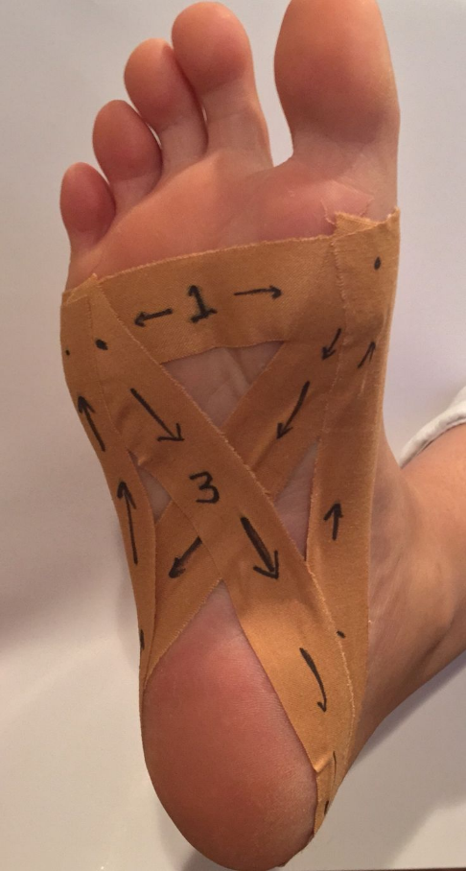
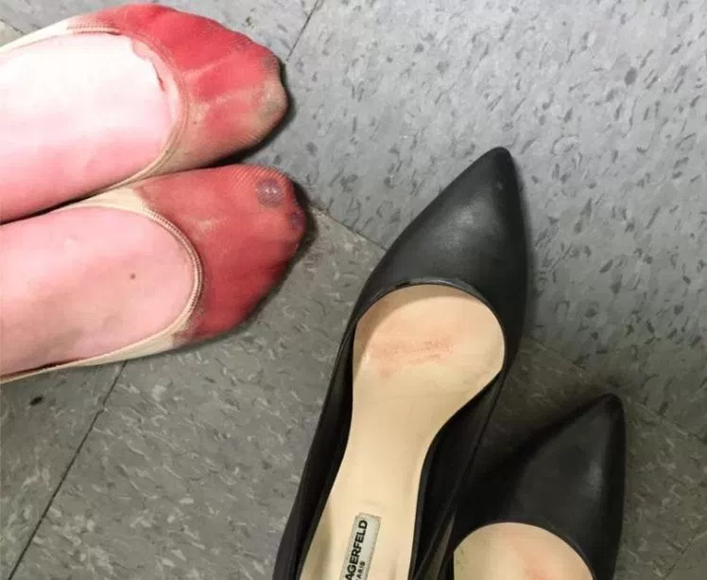
Background Research
Women have to adjust walking gait to stay comfortable.
Use of gel inserts and taping feet are common practices to alleviate pain.
Heels with round toes and short, chunky heels are most comfortable.

Slide 7
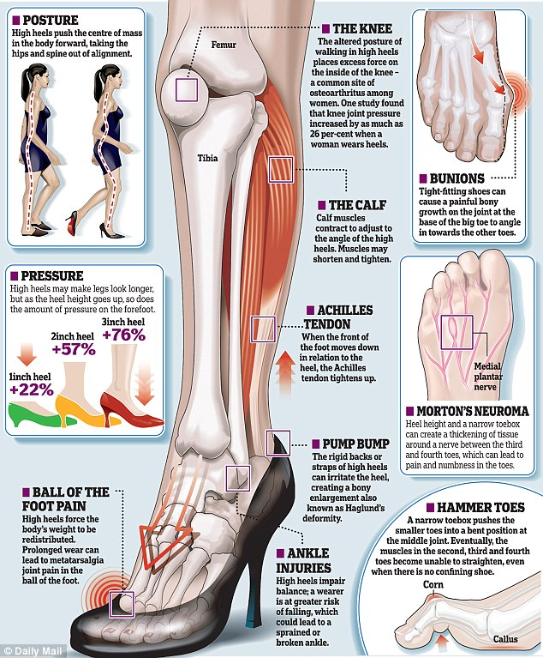
Background Research (Cont.)
Wearing heels for prolonged periods can lead to a variety of medical conditions.
Posture is altered when wearing heels.
Pressure on forefront of foot increases as heel height increases.

Slide 8
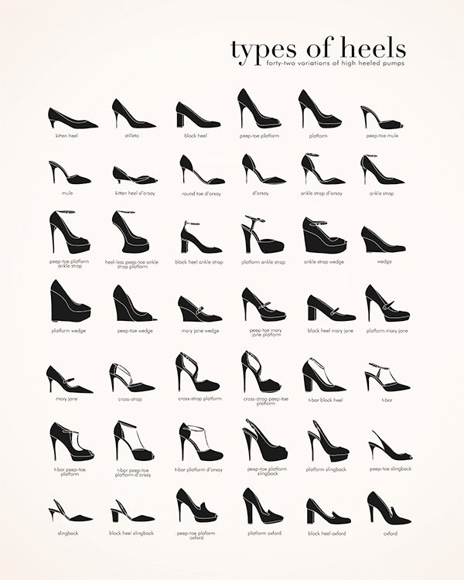
Background Research (Cont.)
There are a variety of heels types.
Some are more comfortable for prolonged use than others.
Women don’t want to sacrifice style for comfort.

Slide 9
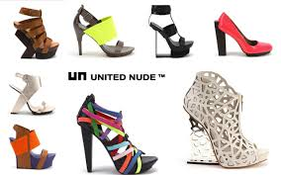
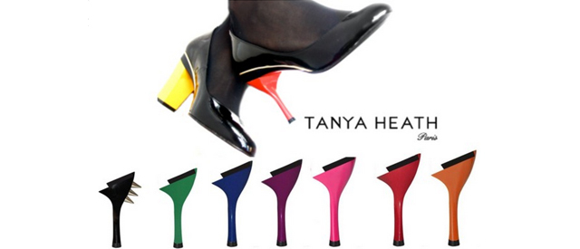
Competitor Analysis
Too unconventional for professional settings
Too expensive for the average person

Slide 10
Primary Market
Women, age 15-45
Professional and personal use
Stylish but also comfortable
Alleviate discomfort without having to carry multiple pairs of shoes

Slide 11
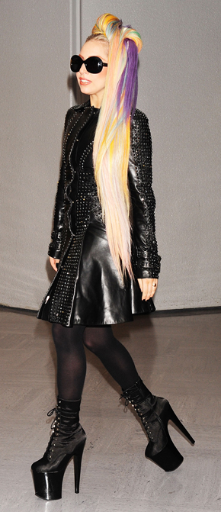
Secondary Market
All heel wearers
Including but not limited to:
Professionals
Performers
People with orthopedic conditions
Fashionistas
Event-goers

Slide 12
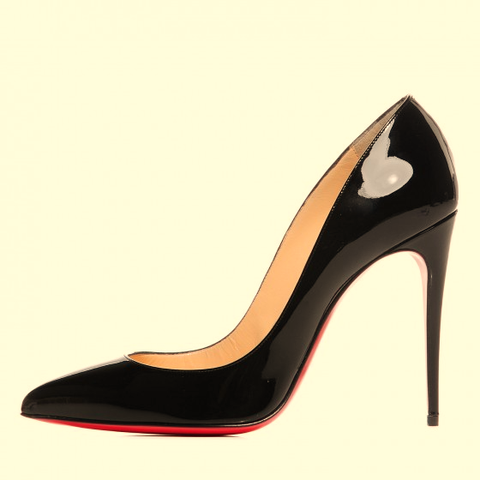
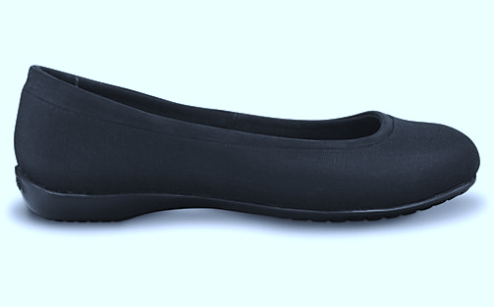
Key Goals
Fashionable
Practical

Slide 13
Customer Needs Survey
Question Asked | Customer Response | Interpreted Need
How long does it take for your feet to start hurting when you wear heels? | 1 hour to 3 hours | The convertible shoe needs to be able to provide comfort easily after prolonged wear.
Have you ever walked barefoot because of the pain highs heels produced in your feet? | Yes | The convertible shoe needs to alleviate stress from the user's feet in its flat state.
Would you buy convertible high heel shoes? | Maybe | The convertible shoe needs to be fashionable, comfortable, and safe.

Slide 14
Customer Needs Survey
How much would you be willing to pay for a convertible high heel? | $50 - $100 | The price of the convertible shoe should be below $100.
Would you want a heel that converted into multiple heights? | Yes | The convertible shoe needs to accommodate for multiple heights.
Would you want a design that did not have any detachable parts? | Yes | The convertible shoe should be able to convert between heights without the user having to remove a piece.
Which is more important to you? (No Detachable Part or Multiple Heights) | No Detachable Part (70%) Multiple Heights (30%) | It is more important to vary height as a singular component than as multiple components.

Slide 15
Need Summary
High heeled shoes are uncomfortable, even painful, for prolonged use.
Current convertible shoes are more expensive than customers wish to spend.
Removable pieces are inconvenient.

Slide 16
Project Scope
Design a convertible high heel shoe
No removable parts
Cost less than $100
Build a working prototype
Compete in the InNOLEvation challenge

Slide 17
Functional Decomposition
Transform to Different Heights
Attach to Foot
Support Foot Ergonom-ically
Shield from Elements
Supply Traction
Impress with Style
Provide Comfort

Slide 18
References
[1] Osteoarthritis. (n.d.). Retrieved October 15, 2017, from http://www.arthritis.org/about-arthritis/types/osteoarthritis
[2] The effects of high heeled shoes on female gait: A review. (2014, January 24). Retrieved October 15, 2017, from http://www.sciencedirect.com/science/article/pii/S10506411140002 5X?via%3Dihub
[3] Metatarsalgia. (2016, November 04). Retrieved October 15, 2017, from http://www.mayoclinic.org/diseases- conditions/metatarsalgia/symptoms-causes/syc-20354790

Slide 19
Questions?

